Slide 1
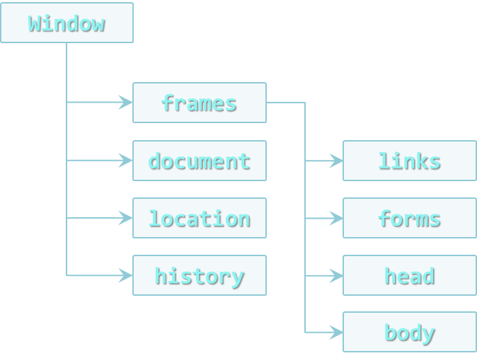

Document Object Model
The True power of dynamic web pages
Doncho Minkov
Senior Technical Trainer
http://minkov.it
Telerik Software Academy
http://academy.telerik.com

Slide 2
Table of Contents
Document Object Model (DOM)
The DOM API
Selecting DOM elements
getElementsBy
querySelector
NodeLists
LiveNodeList
StaticNodeList

Slide 3
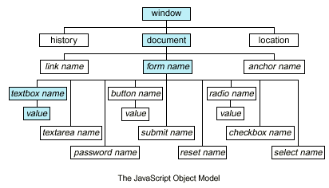
Document Object Model (DOM)

Slide 4
Document Object Model
The Document Object Model is an API for HTML and XML documents
Provides a structural representation of the document
Enables developers to modify the content and visual presentation of a web page

Slide 5
Document Object Model (2)
The Document Object Model consists of many objects to manipulate a web page
All the properties, methods and events are organized into objects
Those objects are accessible through programming languages and scripts
How to use the DOM of an HTML page?
Write JavaScript to interact with the DOM
JavaScript uses the DOM API (native implementation for each browser)

Slide 6
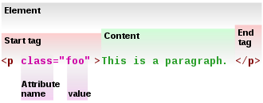
DOM API

Slide 7
DOM API
The DOM API consist of objects and methods to interact with the HTML page
Can add or remove HTML elements
Can apply styles dynamically
Can add and remove HTML attributes
DOM introduces objects that represent HTML elements and their properties
document.documentElement is <html>
document.body is the body of the page

Slide 8
DOM Objects
Each of the HTML elements have corresponding DOM object types
HTMLLIElement represents <li>
HTMLAudioElement represents <audio>
Each of these objects have the appropriate properties
HTMLAnchorElement has href property
HTMLImageElement has src property
The document object is a special object
It represents the entry point for the DOM API

Slide 9
HTML Elements
HTML elements have properties that correspond to the their attributes
id, className, draggable, style, onclick, etc…
Different HTML elements have their specific attributes
HTMLImageElement has property src
HTMLInputElement has property value
HTMLAnchorElement has property href

Slide 10
HTML Elements (2)
HTML elements also have properties corresponding to their content
innerHTML
Returns as a string the content of the element, without the element
outerHTML
Returns as a string the content of the element, with the element
innerText / textContent
Returns as a string the text content of the element, without the tags

Slide 11
DOM Objects
Live Demo

Slide 12
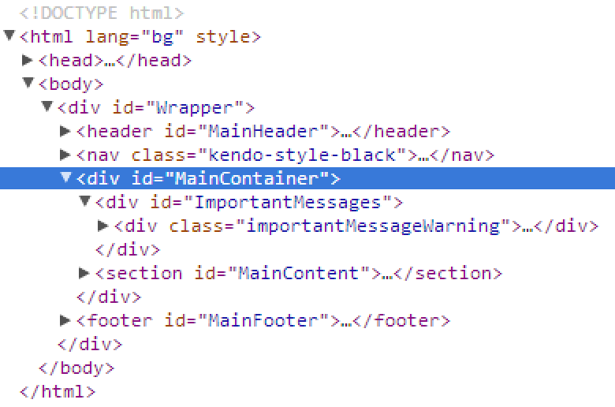
Selecting DOM Elements

Slide 13
Selecting HTML Elements
HTML elements can be found and cached into variables using the DOM API
Select single element
Select a collection of elements
Using predefined collections of elements
var header = document.getElementById("header");
var nav = document.querySelector("#main-nav");
var inputs = document.getElementsByTagName("li");
var radiosGroup = document.getElementsByName("genders[]");
var header = document.querySelectorAll("#main-nav li");
var links = document.links;
var forms = document.forms;

Slide 14
Using getElementsBy Methods
DOM API contains methods for selecting elements based on some characteristic
By Id
By Class
By Tag Name
By Name
var header = document.getElementById("header");
var posts = document.getElementsByClassName("post-item");
var sidebars =document.getElementsByTagName("sidebar");
var gendersGroup = document.getElementsByName("genders[]");

Slide 15
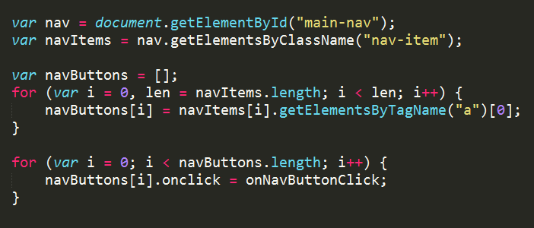
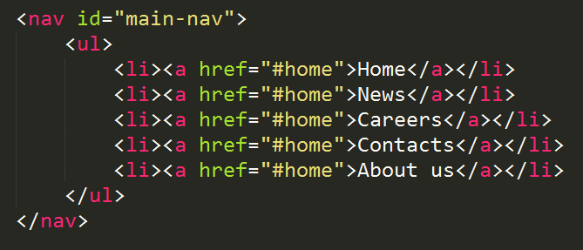
document.getElementsBy…
Live Demo

Slide 16
QuerySelector
The DOM API has methods that use CSS-like selectors to find and select HTML elements
querySelector returns the first element that matches the selector
querySelectorAll returns a collection of all elements that match the selector
Not supported in older browsers (below IE 8)
Both methods take as a string parameter
The CSS selector of the element
var header = document.querySelector("#header");
//the element with id="header"
var navItems = document.querySelectorAll("#main-nav li");
//li elements contained in element with id=main-nav

Slide 17
QuerySelector
Live Demo

Slide 18
Selecting Elements Inside Other Elements
The DOM API can be used to select elements that are inside other elements
Select all divs that are inside an element with id "wrapper"
var wrapper = document.getElementById("wrapper");
var divsInWrapper = wrapper.getElementsByTagName("div");
All methods can be used on HTML elements
Except getElementById()

Slide 19
Selecting Inner Elements
Live Demo

Slide 20
NodeLists

Slide 21
NodeLists
A NodeList is a collection returned by the DOM selector methods:
getElementsByTagName(tagName)
getElementsByName(name)
getElementsByClassName(className)
querySelectorAll(selector)
var divs = document.getElementsByTagName("div");
var queryDivs = document.querySelectorAll("div");
for(var i=0; i< divs.length; i++){
//do stuff with divs[i]…
}

Slide 22
NodeLists (2)
NodeList looks like an array, but is not
It's an object with properties similar to array
Has length and indexer
Traversing an array with for-in loop works unexpected:
for (var i in divs) {
console.log("divs[" + i + "] = " + divs[i]);
}
//divs[0] = ...
//divs[1] = ...
//divs[length] = ...
//divs[item] = ...

Slide 23
NodeList
Live Demo

Slide 24
Static NodeList and Live NodeList

Slide 25
Static and Live NodeLists
There are two kinds of NodeLists
getElementsBy…() return a LiveNodeList
querySelectorAll() returns a StaticNodeList
Live listс keep track of the selected element
Even when changes are made to the DOM
While static list contain the elements as they were at the execution of the method
Keep in mind that LiveNodeList is slower that regular array
Need to cache its length for better performance

Slide 26
Static NodeListand Live NodeList
Live Demo

Slide 27
DOM and DOM Manipulation
http://academy.telerik.com

Slide 28
Homework (2)
Write a script that selects all the div nodes that are directly inside other div elements
Create a function using querySelectorAll()
Create a function using getElementsByTagName()
Create a function that gets the value of <input type="text"> ands prints its value to the console
Crate a function that gets a the value of <input type="color"> and sets the background of the body to this value
*Write a script that shims querySelector and querySelectorAll in older browsers

